Slide 1

Algebra 1
Unit 4, Lesson 11 Writing Equations of Perpendicular Lines Volume 1, pg. 220

Slide 2


Benchmark
MA.912.AR.2.3
Write a linear two-variable equation for a line that is parallel or perpendicular to a given line and goes through a given point.
volume 1, pg. 220

Slide 3
Integrated Mathematical Thinking and Reasoning Standards
MA.K12.MTR.1.1 Actively participate in effortful learning both individually and collectively.
MA.K12.MTR.2.1 Demonstrate understanding by representing problems in multiple ways.
MA.K12.MTR.4.1 Engage in discussions that reflect on the mathematical thinking of self and others.
MA.K12.MTR.5.1 Use patterns and structure to help understand and connect mathematical concepts.
volume 1, pg. 220

Slide 4

Learning Targets
I can write the equation of a line that is perpendicular to a given line through a given point.
I can write the equation of a line that is perpendicular to a given line when given two points.
I can write the equation of a line that is perpendicular to a given line when given a point and the slope.
volume 1, pg. 220

Slide 5

Warm-Up
volume 1, pg. 220

Slide 6
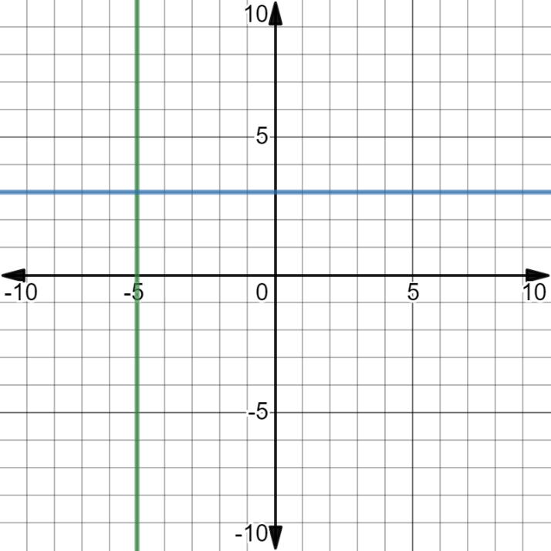
4.11.1 Warm-Up: Horizontal and Vertical Lines
The lines $x=−5$ and $y=3$ are shown on the coordinate grid.
volume 1, pg. 220
Notes:
Video Link: https://algebranation.wistia.com/medias/fi4fidi5y8

Slide 7
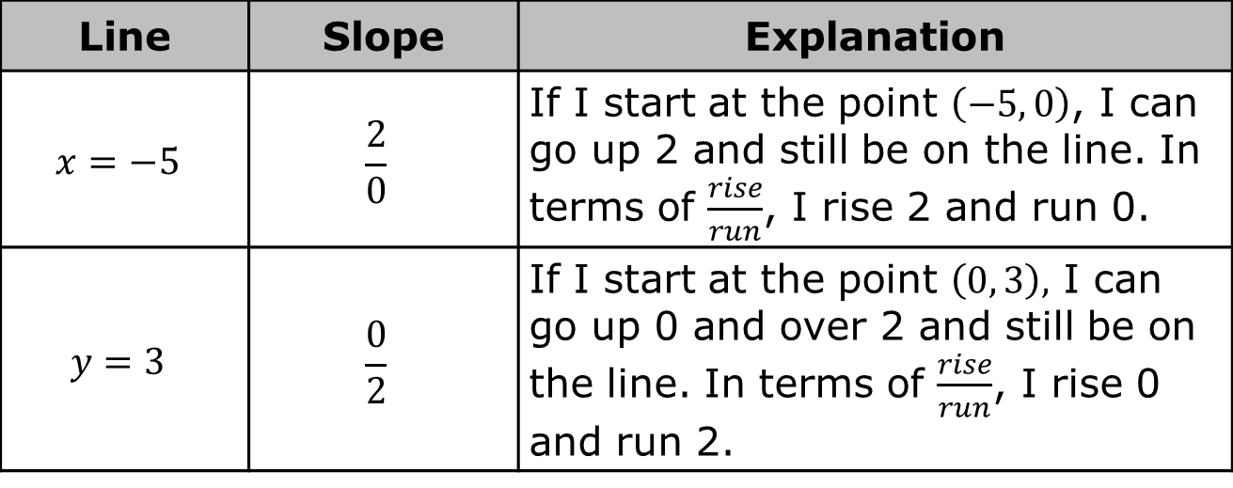
Rodrigo completed the table for the lines $x=−5$ and $y=3$.
Line | Slope | Explanation
$$x=−5$$ | $$\frac{2}{0}$$ | If I start at the point $\left(−5, 0\right)$, I can go up 2 and still be on the line. In terms of $\frac{rise}{run}$, I rise 2 and run 0.
$$y=3$$ | $$\frac{0}{2}$$ | If I start at the point $\left(0, 3\right),$ I can go up 0 and over 2 and still be on the line. In terms of $\frac{rise}{run}$, I rise 0 and run 2.
volume 1, pg. 220

Slide 8

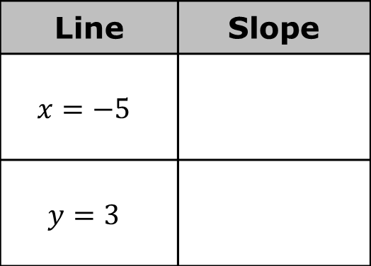
Give another slope Rodrigo could have used for each line.
Write the equation of the line that passes through $(2, 1)$ and is parallel to $x=−5$.
Line | Slope
$$x=−5$$
$$y=3$$
volume 1, pg. 221

Slide 9

Write the equation of the line that passes through $(2, 1)$ and is parallel to $y=3$.
What is the point where $x=−5$ and $y=3$ intersect?
volume 1, pg. 221

Slide 10

Guided Instruction
volume 1, pg. 221

Slide 11

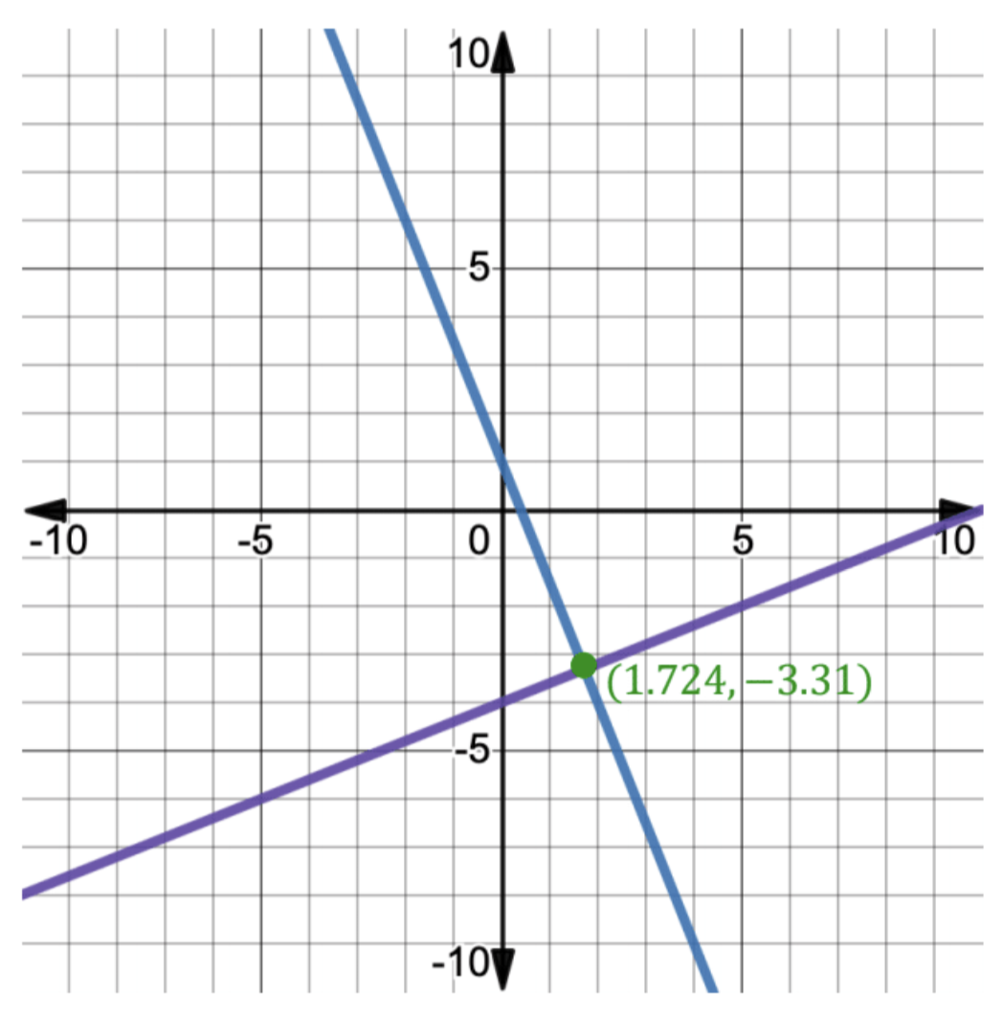
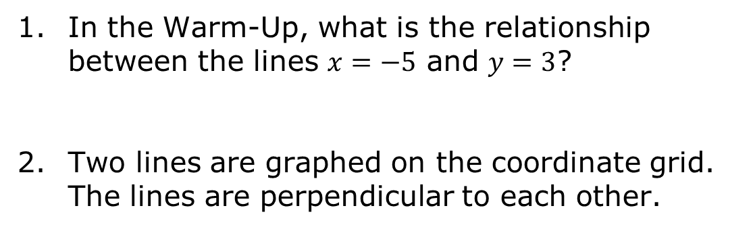
4.11.2 Guided Instruction: Writing Equations of Perpendicular Lines Through a Point
In the Warm-Up, what is the relationship between the lines $x=−5$ and $y=3$?
Two lines are graphed on the coordinate grid. The lines are perpendicular to each other.
volume 1, pg. 221

Slide 12
Find the slope of each line.
Line | Slope
Purple
Blue
volume 1, pg. 221

Slide 13
Write the equation of the purple line.
Write the equation of the blue line.
Discuss with your partner how to write the equation of a line that is perpendicular to another line. Write notes from the discussion.
volume 1, pg. 222

Slide 14

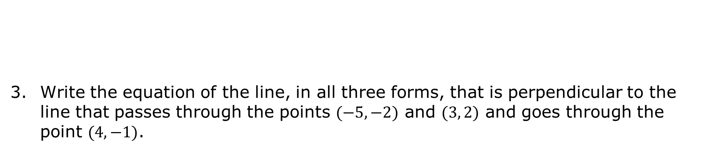
Write the equation of the line, in all three forms, that is perpendicular to the line that passes through the points $(−5, −2)$ and $(3, 2)$ and goes through the point $(4, −1)$.
Lines are perpendicular if the slopes are opposites and reciprocals.
Point-Slope Form | Slope-Intercept Form | Standard Form
volume 1, pg. 222

Slide 15

Guided Practice
volume 1, pg. 222

Slide 16

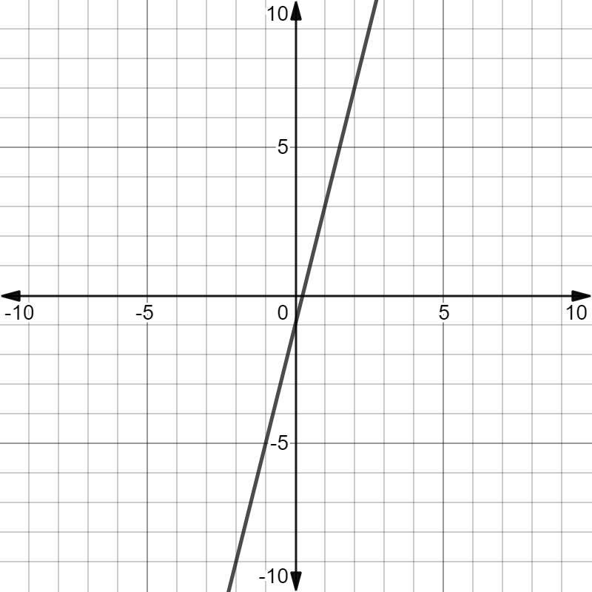
4.11.3 Guided Practice: Writing Equations of Perpendicular Lines Through a Point
Consider the following graph.
volume 1, pg. 222

Slide 17
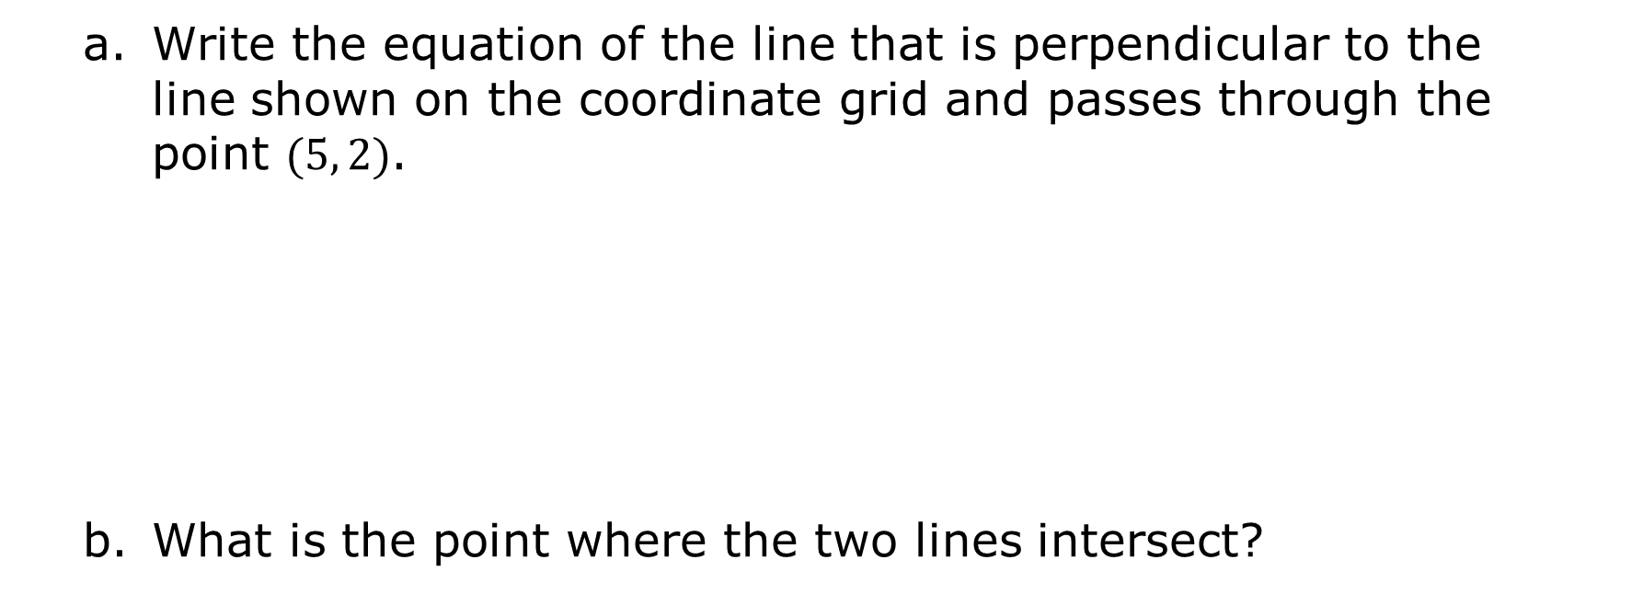
Write the equation of the line that is perpendicular to the line shown on the coordinate grid and passes through the point $(5, 2)$.
What is the point where the two lines intersect?
volume 1, pg. 222

Slide 18
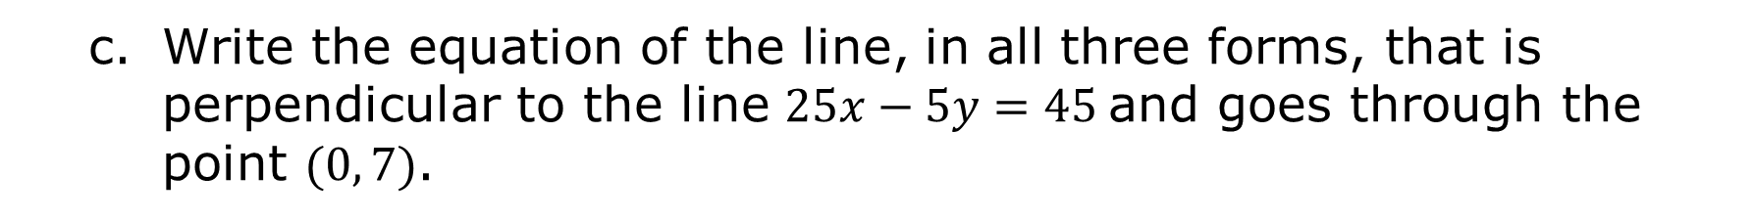
Write the equation of the line, in all three forms, that is perpendicular to the line $25x−5y=45$and goes through the point $(0, 7)$.
Point-Slope Form | Slope-Intercept Form | Standard Form
volume 1, pg. 223

Slide 19
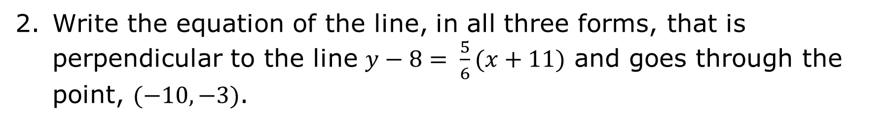
Write the equation of the line, in all three forms, that is perpendicular to the line $y−8= \frac{5}{6}(x+11)$ and goes through the point, $(−10, −3)$.
Point-Slope Form | Slope-Intercept Form | Standard Form
volume 1, pg. 223

Slide 20

Your Turn
volume 1, pg. 223

Slide 21
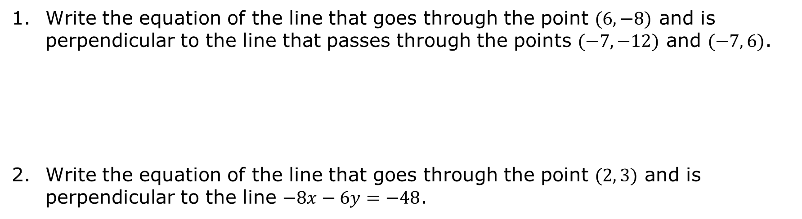
4.11.4 Your Turn!
Write the equation of the line that goes through the point $(6, −8)$ and is perpendicular to the line that passes through the points $(−7, −12)$ and $(−7, 6)$.
Write the equation of the line that goes through the point $(2, 3)$ and is perpendicular to the line $−8x−6y=−48$.
volume 1, pg. 223

Slide 22

Wrap-Up
volume 1, pg. 224

Slide 23
4.11.5 Wrap-Up: Reflection
Complete the learning pyramid.
One question I would like to have answered …
One mistake I learned from today …
One thing I am not sure about … YET!
One thing I am confident I know is …
volume 1, pg. 224

